Slide 1
Y – Z Plane
X– Z Plane
T’
T
T’
θc'
θb
C’
C
θb'
C’
B
Cx
θa'
Zp
B’
Zp
A
A
Yp
Xp
X – Y Plane
Trimetric View
Z
Y
Xp
T
C
Yp
X

Slide 2
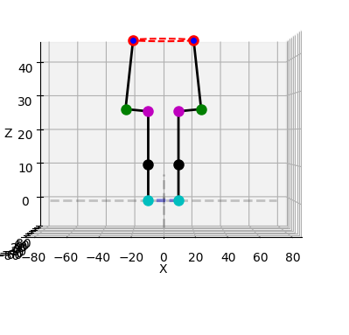
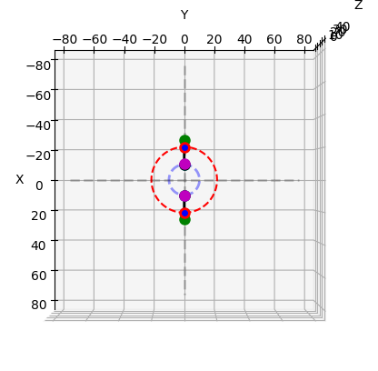
B
A
Θ< 90
Θ< 90
A
B

Slide 3
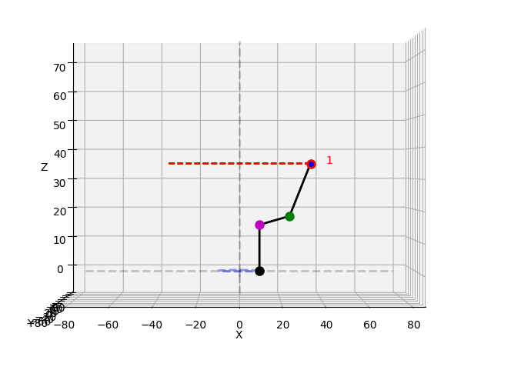
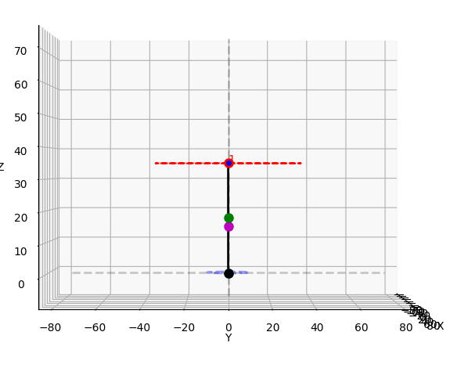
Path

